Slide 1
Prim’s algorithm

Slide 2
Outline
This topic covers Prim’s algorithm:
Finding a minimum spanning tree
The idea and the algorithm
An example

Slide 3
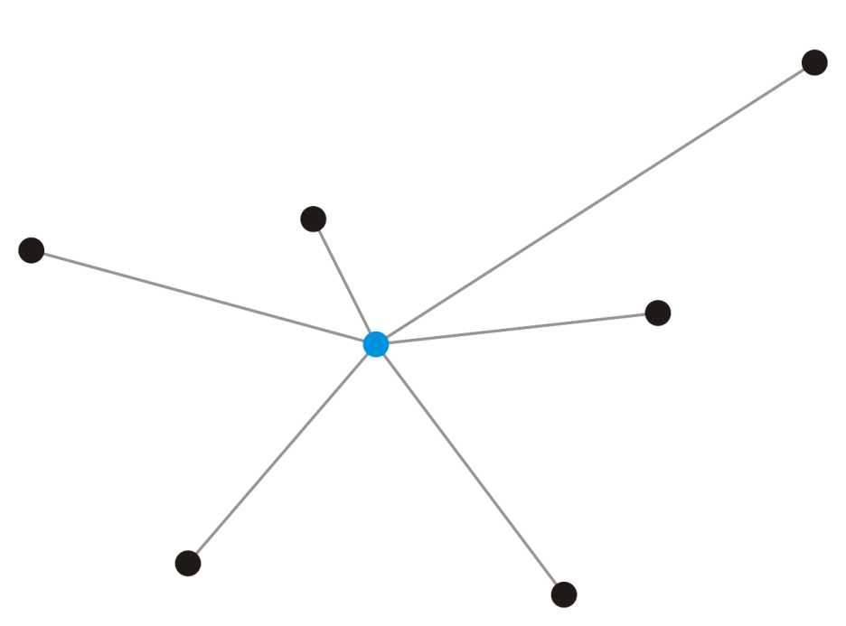
Strategy
Suppose we take a vertex
Given a single vertex e₁, it forms a minimum spanning tree on one vertex
v₁

Slide 4
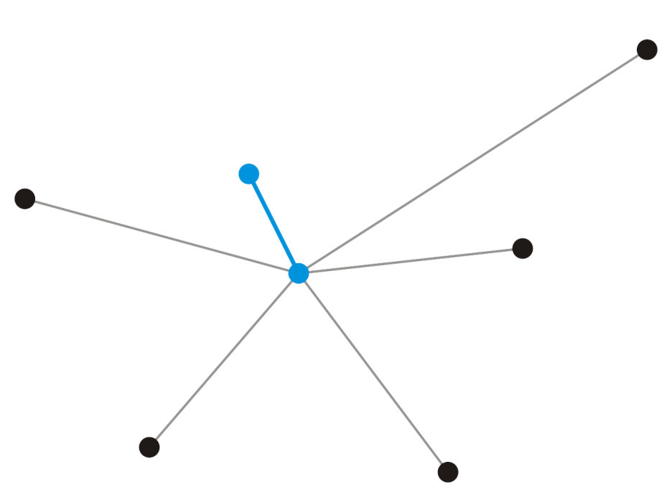
Strategy
Add that adjacent vertex v₂ that has a connecting edge e₁ of minimum weight
This forms a minimum spanning tree on our two vertices and e₁ must be in any minimum spanning tree containing the vertices v₁ and v₂
v₂
e₁
v₁

Slide 5
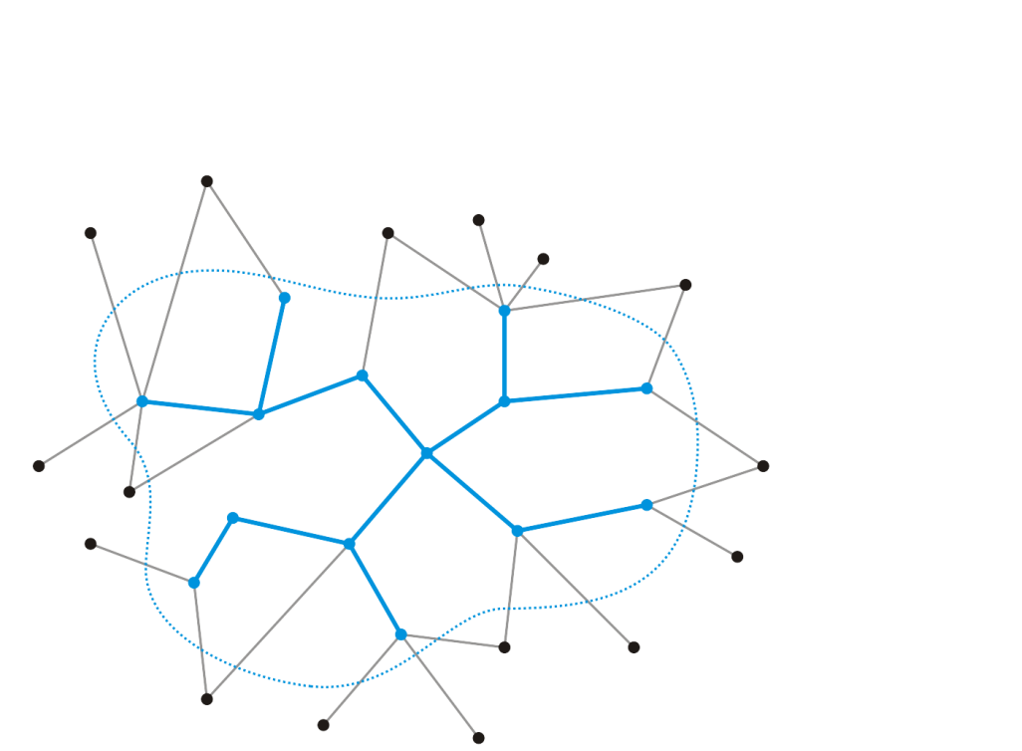
Strategy
Strategy:
Suppose we have a known minimum spanning tree on k < n vertices
How could we extend this minimum spanning tree?

Slide 6

Strategy
Add that edge e_{k} with least weight that connects this minimum spanning tree to a new vertex v_{k + 1}
This does create a minimum spanning tree on k + 1 nodes—there is no other edge we could add that would connect this vertex
Does the new edge, however, belong to the minimum spanning tree on all n vertices?
v_{k + 1}
e_{k}

Slide 7
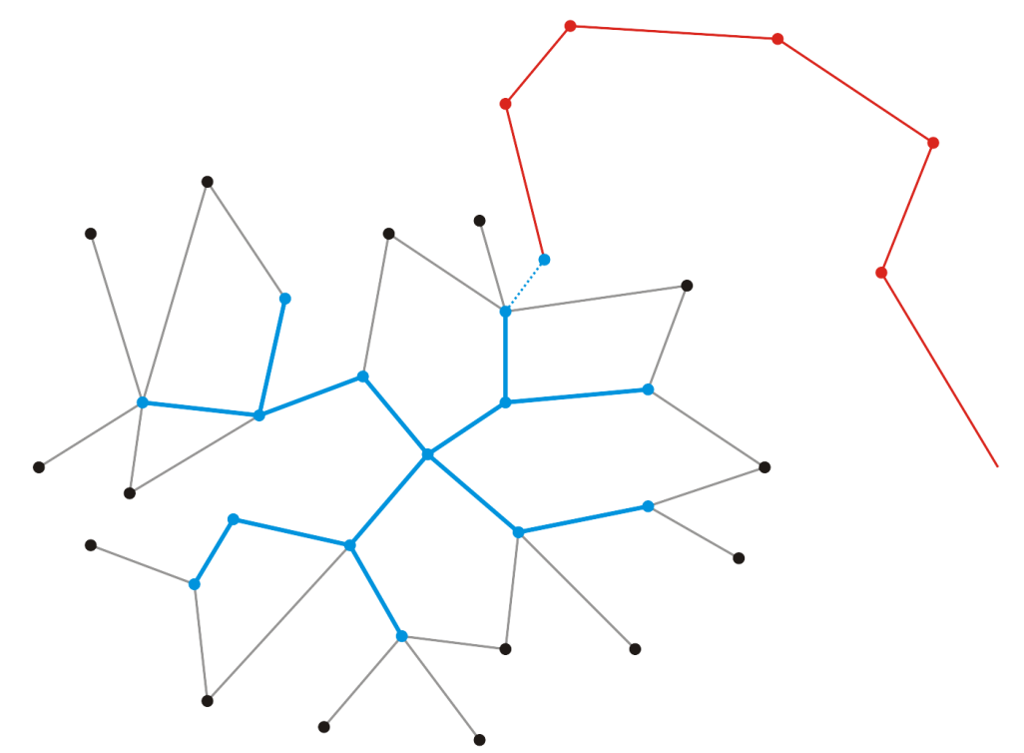
Strategy
Suppose it does not
Thus, vertex v_{k + 1} is connected to the minimum spanning tree via another sequence of edges
v_{k + 1}
e_{k}

Slide 8
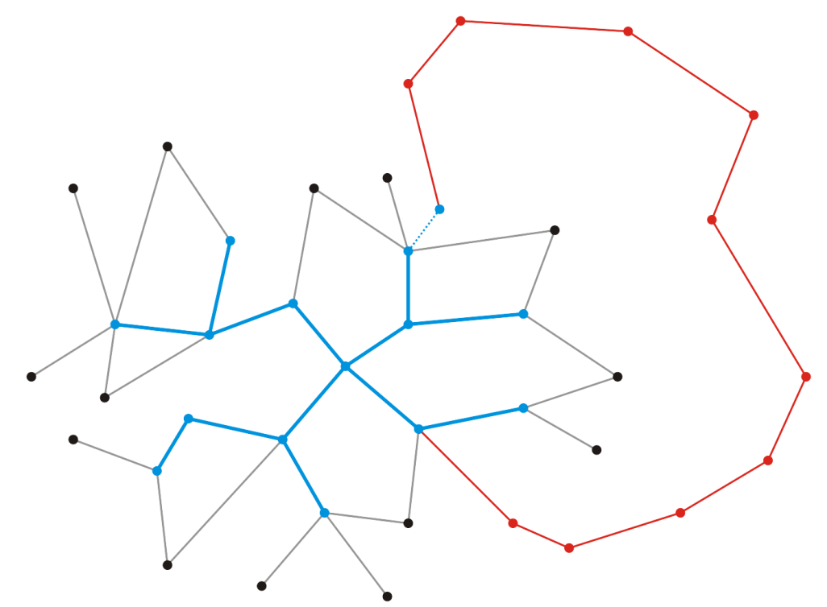
Strategy
Because a minimum spanning tree is connected, there must be a path from vertex v_{k + 1} back to our existing minimum spanning tree
It must be connected along some edge
v_{k + 1}
e_{k}

Slide 9
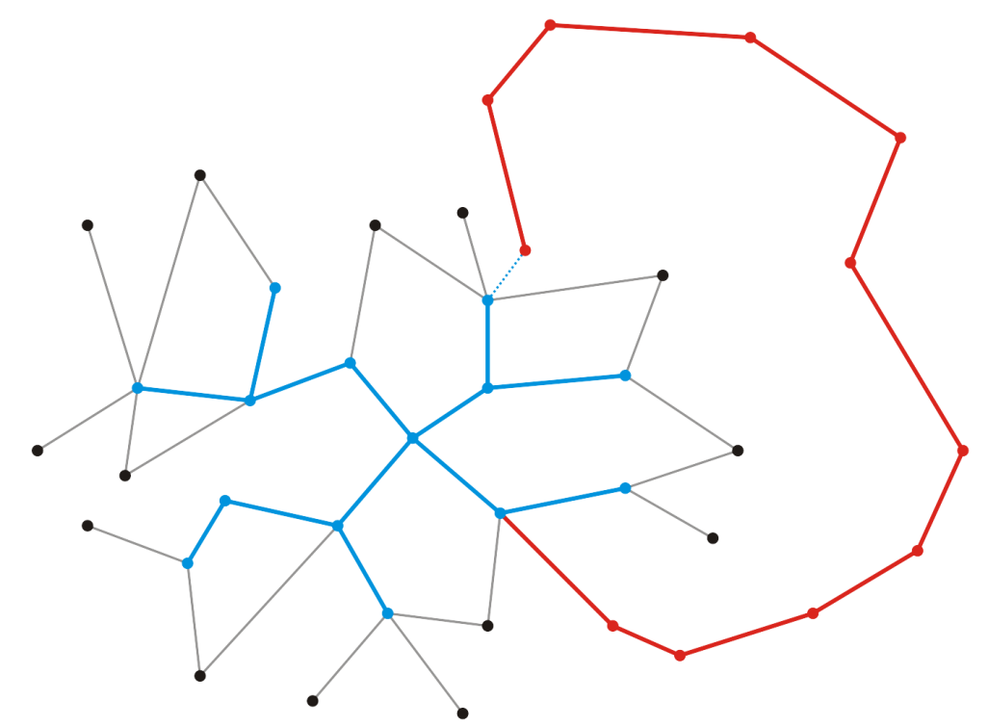
Strategy
Let w be the weight of this minimum spanning tree
Recall, however, that when we chose to add v_{k + 1}, it was because e_{k} was the edge connecting an adjacent vertex with least weight
Therefore where |e| represents the weight of the edge e
v_{k + 1}
e_{k}

Slide 10
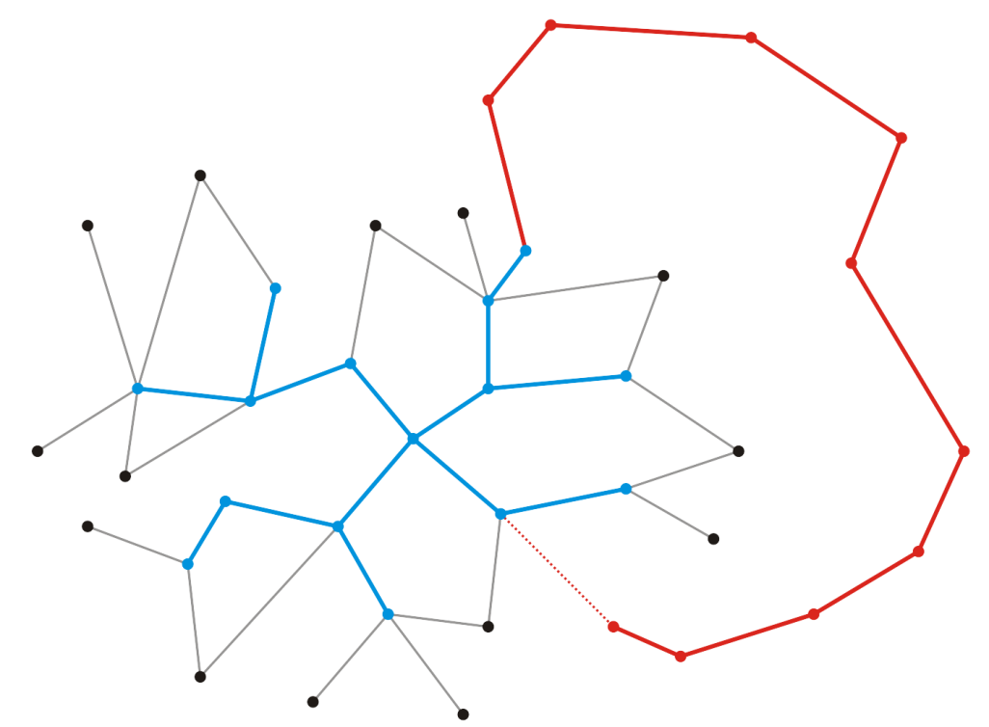
Strategy
Consider, however, suppose we swap edges and instead choose to include e_{k} and exclude
The result is still a minimum spanning tree, but the weight is now
v_{k + 1}
e_{k + 1}

Slide 11
Strategy
Thus, by swapping e_{k} for , we have a spanning tree that has less weight than the so-called minimum spanning tree containing
This contradicts our assumption that the spanning tree containing was minimal
Therefore, our minimum spanning tree must contain e_{k}
v_{k + 1}
e_{k}

Slide 12
Strategy
Recall that we did not prescribe the value of k, and thus, k could be any value, including k = 1
v_{k + 1}
e_{k}

Slide 13
Strategy
Recall that we did not prescribe the value of k, and thus, k could be any value, including k = 1
Given a single vertex e₁, it forms a minimum spanning tree on one vertex
v₁

Slide 14
Strategy
Add that adjacent vertex v₂ that has a connecting edge e₁ of minimum weight
This forms a minimum spanning tree on our two vertices and e₁ must be in any minimum spanning tree containing the vertices v₁ and v₂
v₂
e₁
v₁

Slide 15
Minimum Spanning Trees
Prim’s algorithm for finding the minimum spanning tree states:
Start with an arbitrary vertex to form a minimum spanning tree on one vertex
At each step, add that vertex v not yet in the minimum spanning tree that has an edge with least weight that connects v to the existing minimum spanning sub-tree
Continue until we have n – 1 edges and n vertices
Another possibility is Kruskal’s algorithm

Slide 16
Prim's Algorithm
{
T = ;
U = { 1 };
while (U V)
{
let (u, v) be the lowest cost edge such that u U and v V - U;
T = T {(u, v)}
U = U {v}
}
}
Notes:
O(n²) algorithm.

Slide 17
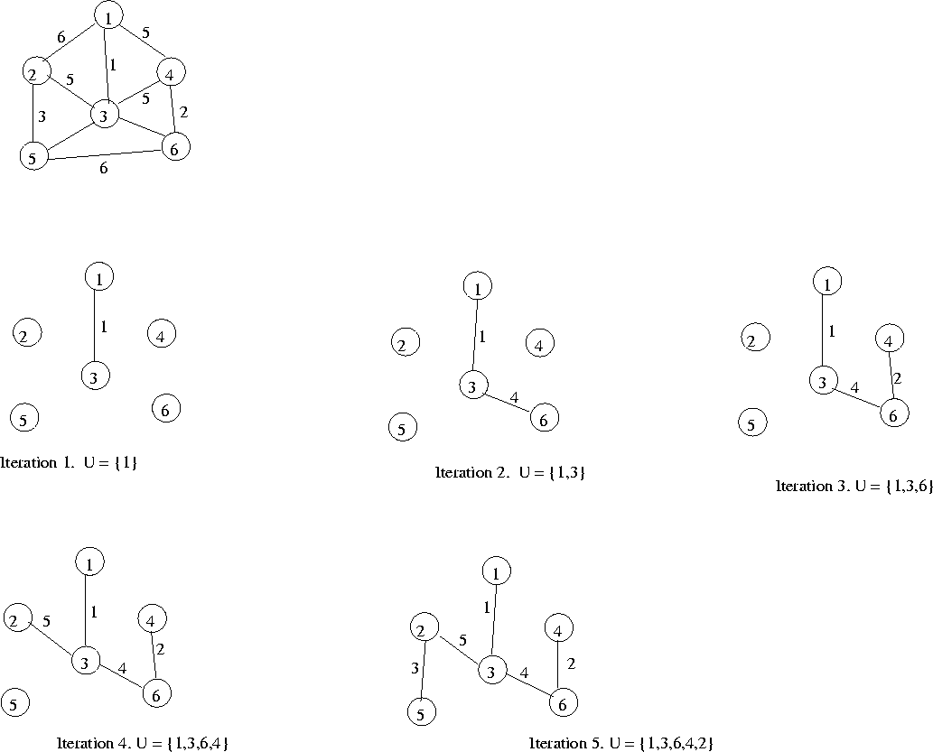
Example
http://lcm.csa.iisc.ernet.in/dsa/node183.html

Slide 18
Example

Slide 19
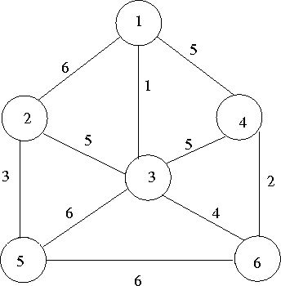
{Step 1}
U = {1} V - U = {2, 3, 4, 5, 6}
closest lowcost
V - U U
2 1 6
3 1 1
4 1 5
5 1 $ \infty$
6 1 $ \infty$
Select vertex 3 to include in U
{Step 2}
U = {1, 3} V - U = {2, 4, 5, 6}
closest lowcost
V - U U
2 3 5
4 1 5
5 3 6
6 3 4
Now select vertex 6
{Step3}
U = {1, 3, 6} V - U = {2, 4, 5, 6}
closest lowcost
V - U U
2 3 5
4 6 2
5 3 6
Now select vertex 4, and so on
Notes:
Use two arrays, closest and lowcost.
For i belong to V - U, closest[i] gives the vertex in U that is closest to i
For I belong to V - U, lowcost[i] gives the cost of the edge (i, closest(i))

Slide 20
Prim’s Algorithm
Associate with each vertex three items of data:
A Boolean flag indicating if the vertex has been visited,
The minimum distance to the partially constructed tree, and
A pointer to that vertex which will form the parent node in the resulting tree
For example:
Add three member variables to the vertex class
Track three tables

Slide 21
Prim’s Algorithm
Initialization:
Select a root node and set its distance as 0
Set the distance to all other vertices as ∞
Set all vertices to being unvisited
Set the parent pointer of all vertices to 0

Slide 22
Prim’s Algorithm
Iterate while there exists an unvisited vertex with distance < ∞
Select that unvisited vertex with minimum distance
Mark that vertex as having been visited
For each adjacent vertex, if the weight of the connecting edge is less than the current distance to that vertex:
Update the distance to equal the weight of the edge
Set the current vertex as the parent of the adjacent vertex

Slide 23
Prim’s Algorithm
Halting Conditions:
There are no unvisited vertices which have a distance < ∞
If all vertices have been visited, we have a spanning tree of the entire graph
If there are vertices with distance ∞, then the graph is not connected and we only have a minimum spanning tree of the connected sub-graph containing the root

Slide 24
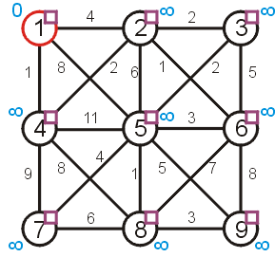
Prim’s Algorithm
Let us find the minimum spanning tree for the following undirected weighted graph

Slide 25
Prim’s Algorithm
First we set up the appropriate table and initialize it
 |  | Distance | Parent
1 | F | 0 | 0
2 | F | ∞ | 0
3 | F | ∞ | 0
4 | F | ∞ | 0
5 | F | ∞ | 0
6 | F | ∞ | 0
7 | F | ∞ | 0
8 | F | ∞ | 0
9 | F | ∞ | 0

Slide 26
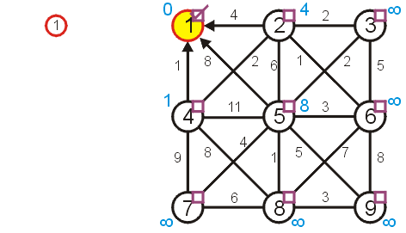
Prim’s Algorithm
Visiting vertex 1, we update vertices 2, 4, and 5
 |  | Distance | Parent
1 | T | 0 | 0
2 | F | 4 | 1
3 | F | ∞ | 0
4 | F | 1 | 1
5 | F | 8 | 1
6 | F | ∞ | 0
7 | F | ∞ | 0
8 | F | ∞ | 0
9 | F | ∞ | 0

Slide 27
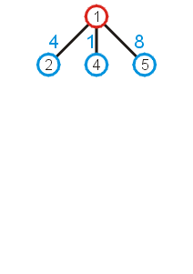
Prim’s Algorithm
What these numbers really mean is that at this point, we could extend the trivial tree containing just the root node by one of the three possible children:
As we wish to find a minimum spanning tree, it makes sense we add that vertex with a connecting edge with least weight

Slide 28
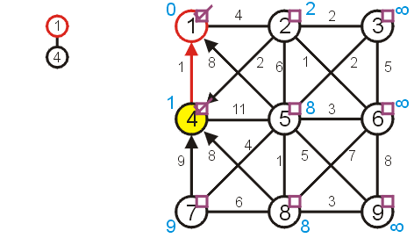
Prim’s Algorithm
The next unvisited vertex with minimum distance is vertex 4
Update vertices 2, 7, 8
Don’t update vertex 5
 |  | Distance | Parent
1 | T | 0 | 0
2 | F | 2 | 4
3 | F | ∞ | 0
4 | T | 1 | 1
5 | F | 8 | 1
6 | F | ∞ | 0
7 | F | 9 | 4
8 | F | 8 | 4
9 | F | ∞ | 0

Slide 29
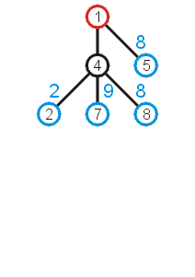
Prim’s Algorithm
Now that we have updated all vertices adjacent to vertex 4, we can extend the tree by adding one of the edges
(1, 5), (4, 2), (4, 7), or (4, 8)
We add that edge with the least weight: (4, 2)

Slide 30
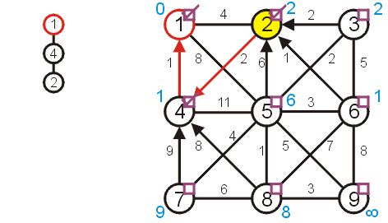
Prim’s Algorithm
Next visit vertex 2
Update 3, 5, and 6
 |  | Distance | Parent
1 | T | 0 | 0
2 | T | 2 | 4
3 | F | 2 | 2
4 | T | 1 | 1
5 | F | 6 | 2
6 | F | 1 | 2
7 | F | 9 | 4
8 | F | 8 | 4
9 | F | ∞ | 0

Slide 31
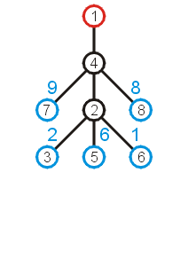
Prim’s Algorithm
Again looking at the shortest edges to each of the vertices adjacent to the current tree, we note that we can add (2, 6) with the least increase in weight

Slide 32
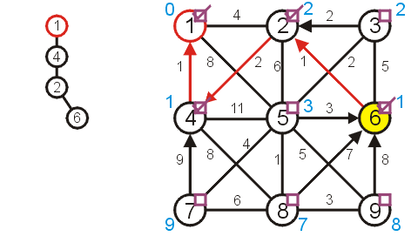
Prim’s Algorithm
Next, we visit vertex 6:
update vertices 5, 8, and 9
 |  | Distance | Parent
1 | T | 0 | 0
2 | T | 2 | 4
3 | F | 2 | 2
4 | T | 1 | 1
5 | F | 3 | 6
6 | T | 1 | 2
7 | F | 9 | 4
8 | F | 7 | 6
9 | F | 8 | 6

Slide 33
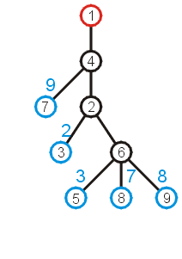
Prim’s Algorithm
The edge with least weight is (2, 3)
This adds the weight of 2 to the weight minimum spanning tree

Slide 34
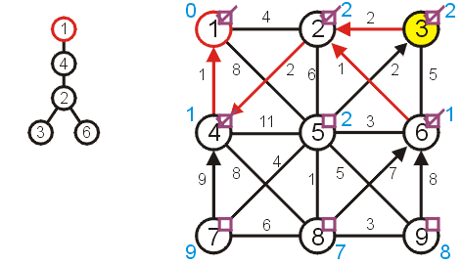
Prim’s Algorithm
Next, we visit vertex 3 and update 5
 |  | Distance | Parent
1 | T | 0 | 0
2 | T | 2 | 4
3 | T | 2 | 2
4 | T | 1 | 1
5 | F | 2 | 3
6 | T | 1 | 2
7 | F | 9 | 4
8 | F | 7 | 6
9 | F | 8 | 6

Slide 35
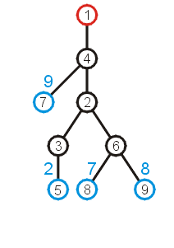
Prim’s Algorithm
At this point, we can extend the tree by adding the edge (3, 5)

Slide 36
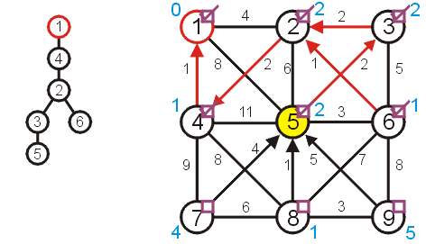
Prim’s Algorithm
Visiting vertex 5, we update 7, 8, 9
 |  | Distance | Parent
1 | T | 0 | 0
2 | T | 2 | 4
3 | T | 2 | 2
4 | T | 1 | 1
5 | T | 2 | 3
6 | T | 1 | 2
7 | F | 4 | 5
8 | F | 1 | 5
9 | F | 5 | 5

Slide 37
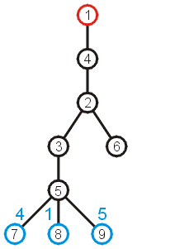
Prim’s Algorithm
At this point, there are three possible edges which we could include which will extend the tree
The edge to 8 has the least weight

Slide 38
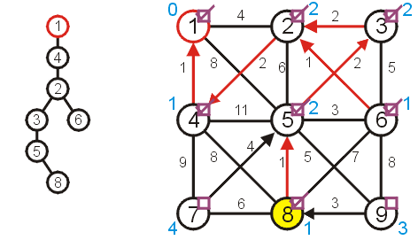
Prim’s Algorithm
Visiting vertex 8, we only update vertex 9
 |  | Distance | Parent
1 | T | 0 | 0
2 | T | 2 | 4
3 | T | 2 | 2
4 | T | 1 | 1
5 | T | 2 | 3
6 | T | 1 | 2
7 | F | 4 | 5
8 | T | 1 | 5
9 | F | 3 | 8

Slide 39
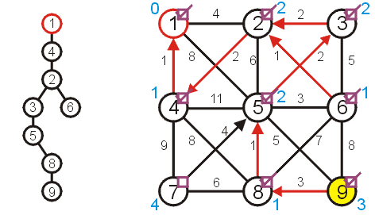
Prim’s Algorithm
There are no other vertices to update while visiting vertex 9
 |  | Distance | Parent
1 | T | 0 | 0
2 | T | 2 | 4
3 | T | 2 | 2
4 | T | 1 | 1
5 | T | 2 | 3
6 | T | 1 | 2
7 | F | 4 | 5
8 | T | 1 | 5
9 | T | 3 | 8

Slide 40
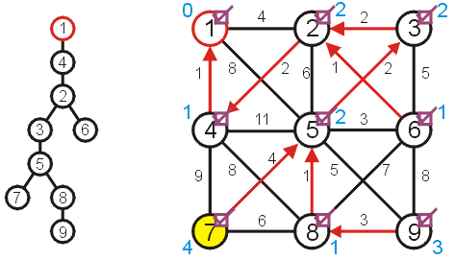
Prim’s Algorithm
And neither are there any vertices to update when visiting vertex 7
 |  | Distance | Parent
1 | T | 0 | 0
2 | T | 2 | 4
3 | T | 2 | 2
4 | T | 1 | 1
5 | T | 2 | 3
6 | T | 1 | 2
7 | T | 4 | 5
8 | T | 1 | 5
9 | T | 3 | 8

Slide 41
Prim’s Algorithm
At this point, there are no more unvisited vertices, and therefore we are done
If at any point, all remaining vertices had a distance of ∞, this would indicate that the graph is not connected
in this case, the minimum spanning tree would only span one connected sub-graph

Slide 42
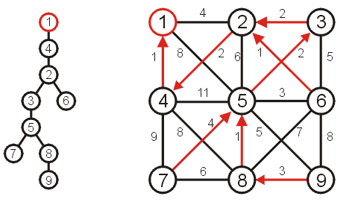
Prim’s Algorithm
Using the parent pointers, we can now construct the minimum spanning tree
 |  | Distance | Parent
1 | T | 0 | 0
2 | T | 2 | 4
3 | T | 2 | 2
4 | T | 1 | 1
5 | T | 2 | 3
6 | T | 1 | 2
7 | T | 4 | 5
8 | T | 1 | 5
9 | T | 3 | 8

Slide 43
Prim’s Algorithm
To summarize:
we begin with a vertex which represents the root
starting with this trivial tree and iteration, we find the shortest edge which we can add to this already existing tree to expand it
This is a reasonably efficient algorithm: the number of visits to vertices is kept to a minimum

Slide 44
Implementation and analysis
The initialization requires Θ(|V|) memory and run time
We iterate |V| – 1 times, each time finding the closest vertex
Iterating through the table requires is Θ(|V|) time
Each time we find a vertex, we must check all of its neighbors
With an adjacency matrix, the run time is Θ(|V|(|V| + |V|)) = Θ(|V|²)
With an adjacency list, the run time is Θ(|V|² + |E|) = Θ(|V|²) as |E| = O(|V|²)
Can we do better?
Recall, we only need the shortest edge next
How about a priority queue?
Assume we are using a binary heap
We will have to update the heap structure—this requires additional work

Slide 45
Implementation and analysis
The initialization still requires Θ(|V|) memory and run time
The priority queue will also requires Ο(|V|) memory
We iterate |V| – 1 times, each time finding the closest vertex
Place the shortest distances into a priority queue
The size of the priority queue is Ο(|V|)
Thus, the work required for this is O(|V| ln(|V|))
Is this all the work that is necessary?
Recall that each edge visited may result in a new edge being pushed to the very top of the heap
Thus, the work required for this is O(|E| ln(|V|))
Thus, the total run time is O(|V| ln(|V|) + |E| ln(|V|)) = O(|E| ln(|V|))

Slide 46
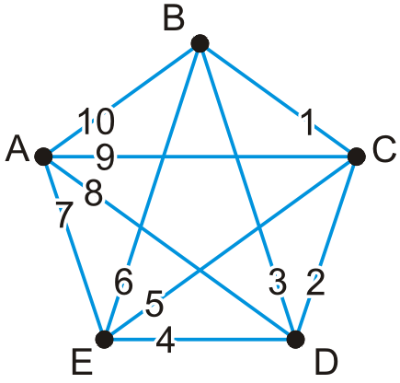
Implementation and analysis
Here is a worst-case graph if we were to start with Vertex A
Assume that the adjacency lists are in order
Each time, the edge is percolated to the top of the heap

Slide 47
Implementation and analysis
We could use a different heap structure:
A Fibonacci heap is a node-based heap
Pop is still O(ln(|V|)), but inserting and moving a key is Θ(1)
Thus, because we are only calling pop |V| – 1 times, work required reduces to O(|E| + |V| ln(|V|))
Thus, the overall run-time is O(|E| + |V| ln(|V|))

Slide 48
Implementation and analysis
Thus, we have two run times when using
A binary heap: O(|E| ln(|V|))
A Fibonacci heap: O(|E| + |V| ln(|V|))
Questions: Which is faster if |E| = Θ(|V|)? How about if |E| = Θ(|V|²)?

Slide 49
Summary
We have seen an algorithm for finding minimum spanning trees
Start with a trivial minimum spanning tree and grow it
An alternate algorithm, Kruskal’s algorithm, uses a different approach
Prim’s algorithm finds an edge with least weight which grows an already existing tree
It solves the problem in O(|E| ln(|V|)) time

Slide 50
References
Wikipedia, http://en.wikipedia.org/wiki/Minimum_spanning_tree
Wikipedia, http://en.wikipedia.org/wiki/Prim’s_algorithm
These slides are provided for the ECE 250 Algorithms and Data Structures course. The material in it reflects Douglas W. Harder’s best judgment in light of the information available to him at the time of preparation. Any reliance on these course slides by any party for any other purpose are the responsibility of such parties. Douglas W. Harder accepts no responsibility for damages, if any, suffered by any party as a result of decisions made or actions based on these course slides for any other purpose than that for which it was intended.

